Slide 1

Stroke Prediction Analysis

Slide 2
Problem Description
Goal: Detection (Prediction) of the possibility of a stroke in a person based on various parameters
Data exploration and model building will answer the following questions:
How does the incidence of stroke vary based on the patient's smoking status? Are former smokers at a higher risk of stroke than current smokers or non-smokers?
Is there any difference in stroke incidence between rural and urban areas?
What is the distribution of patients with hypotension or heart disease? Is the incidence of stroke higher in patients with these conditions?
Does work related stress,low physical activity and long working hours associate to risk of having stroke?
Is proportion of stroke higher in female than male?
Notes:
Angel

Slide 3
Data Description
No. | Attribute | Description
1 | ID | Patient unique identifier
2 | Gender | “male”, “female”, or “other”
3 | Age | Age of the patient
4 | Hypotension | 0 if patient doesn’t have hypotension, 1 if they do
5 | Heart disease | 0 if patient doesn’t have heart disease, 1 if they do
6 | Marital status | “yes” or “no”
7 | Work type | "children", "Govt_jov", "Never_worked", "Private" or "Self-employed"
8 | Residence | “rural” or “urban”
9 | Average glucose level | Average glucose level In blood
10 | BMI | Body mass index
11 | Smoking status | "formerly smoked", "never smoked", "smokes" or "Unknown"
12 | Stroke | 1 if the patient had a stroke or 0 if not
We have taken the data source from Kaggle (https://www.kaggle.com/datasets/fedesoriano/stroke-prediction-dataset)
This data source include 12 input parameters and over 5000 observations
Notes:
Angel

Slide 4
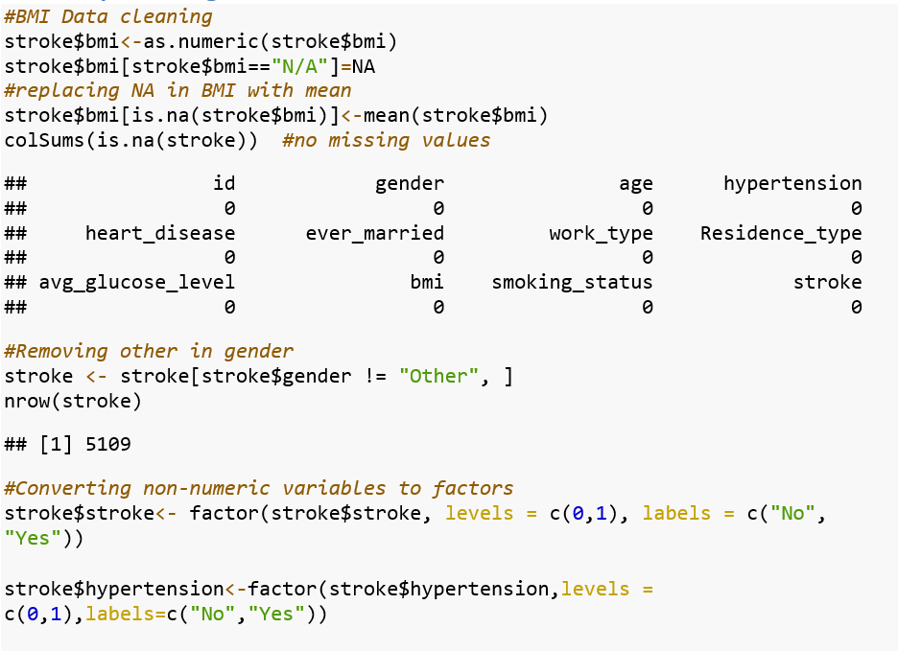
Data Cleaning
Notes:
Rudranil

Slide 5
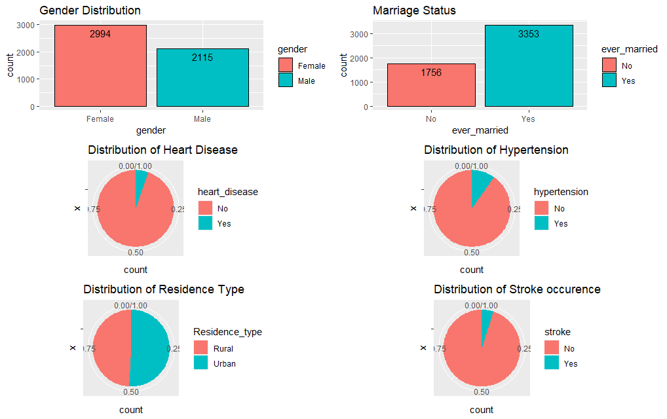
Data Exploration
Notes:
Pragati

Slide 6
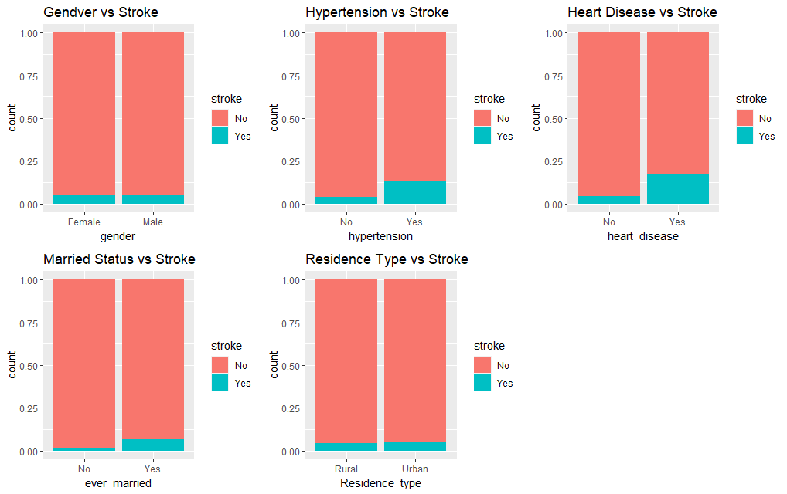
Data Exploration
Notes:
Pragati

Slide 7
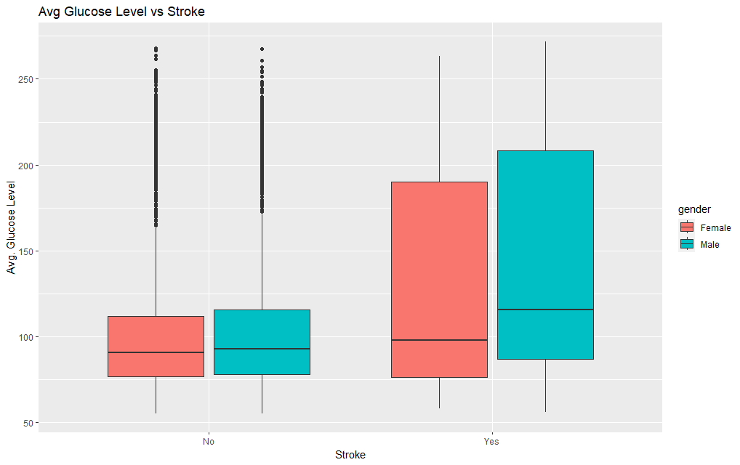
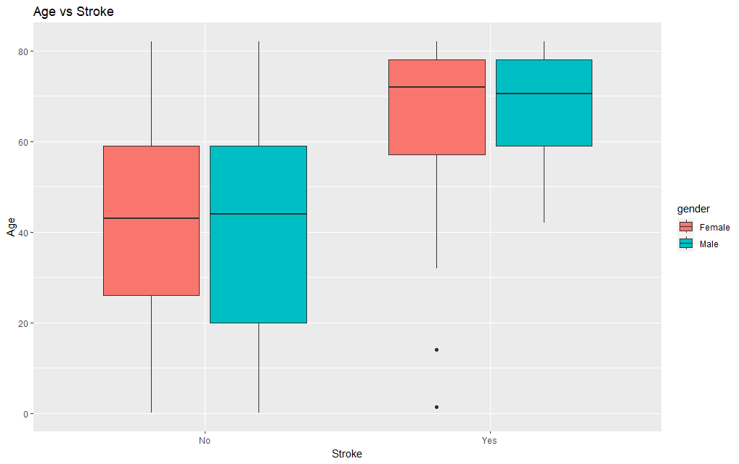
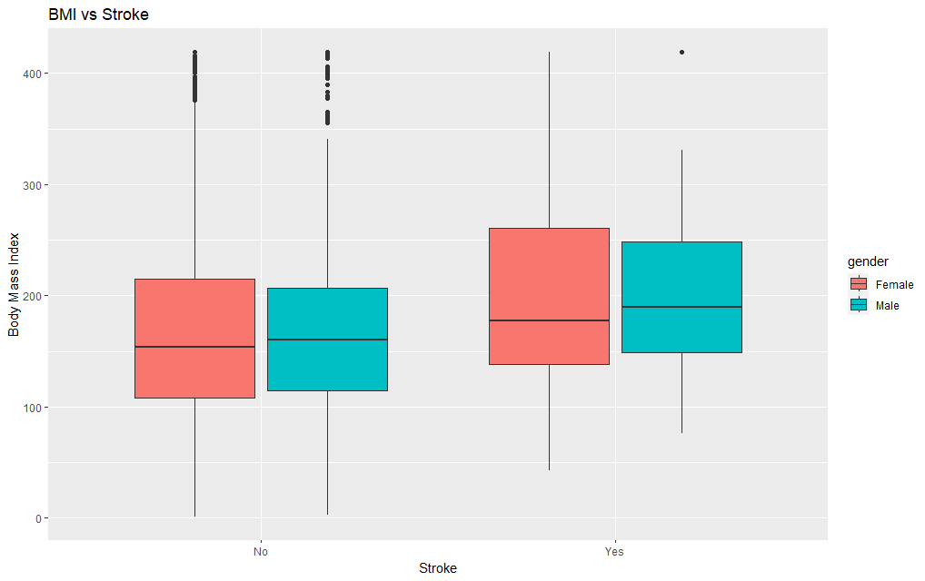
Data Exploration
Notes:
Pragati

Slide 8
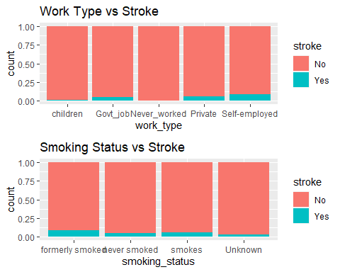
Data Exploration
Notes:
Pragati

Slide 9
Model Building
Data splitting
Training Data
Testing Data
Hyperparameter tunning
Training Models
Predicting Different models
Model Evaluation
Notes:
chhayansh

Slide 10
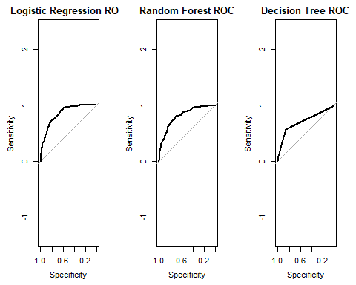
ROC –AUC plot
Notes:
Chhayansh

Slide 11
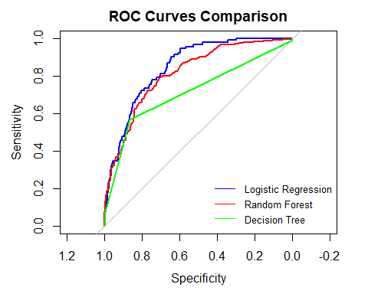
Model Comparision
Prediction Model | AUC
Decision Tree | 0.7161431
Logistic Regression | 0.8468072
Random Forest | 0.8137218
Notes:
chhayansh

Slide 12
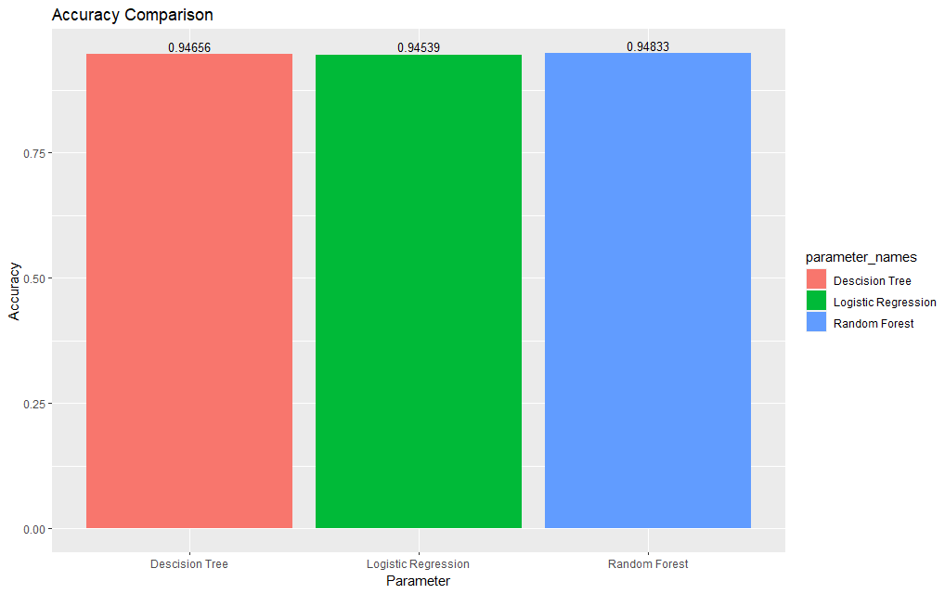
Accuracy
Prediction Model | Accuracy
Decision Tree | 0.9465649
Logistic Regression | 0.9453905
Random Forest | 0.9483265

Slide 13
Conclusion
Through Exploratory Data Analysis it can be interpreted that Avg glucose level, BMI, Hypertension and heart disease are the biggest risk factors for stroke.
From our three models ie. Decision tree, Random forest and Logistic regression , Random forest gives best accuracy.
Logistic Regression gives best ROC-AUC curve than Decision tree and Random forest.
Considering the significant class imbalance in the dataset, accuracy may not be an appropriate metric for evaluating the models.
If the goal is to optimize the model's performance in identifying stroke cases, even at the cost of some false positives, ROC-AUC may be a more appropriate metric to use.
If the cost of false positives is very high, and a balance between precision and recall is desired, accuracy may be a better metric to use.
Notes:
Jeswin

